Slide 1


Python Lists & Tuples
A beginner's guide to storing, organizing, and working with collections of data in Python.

Slide 2
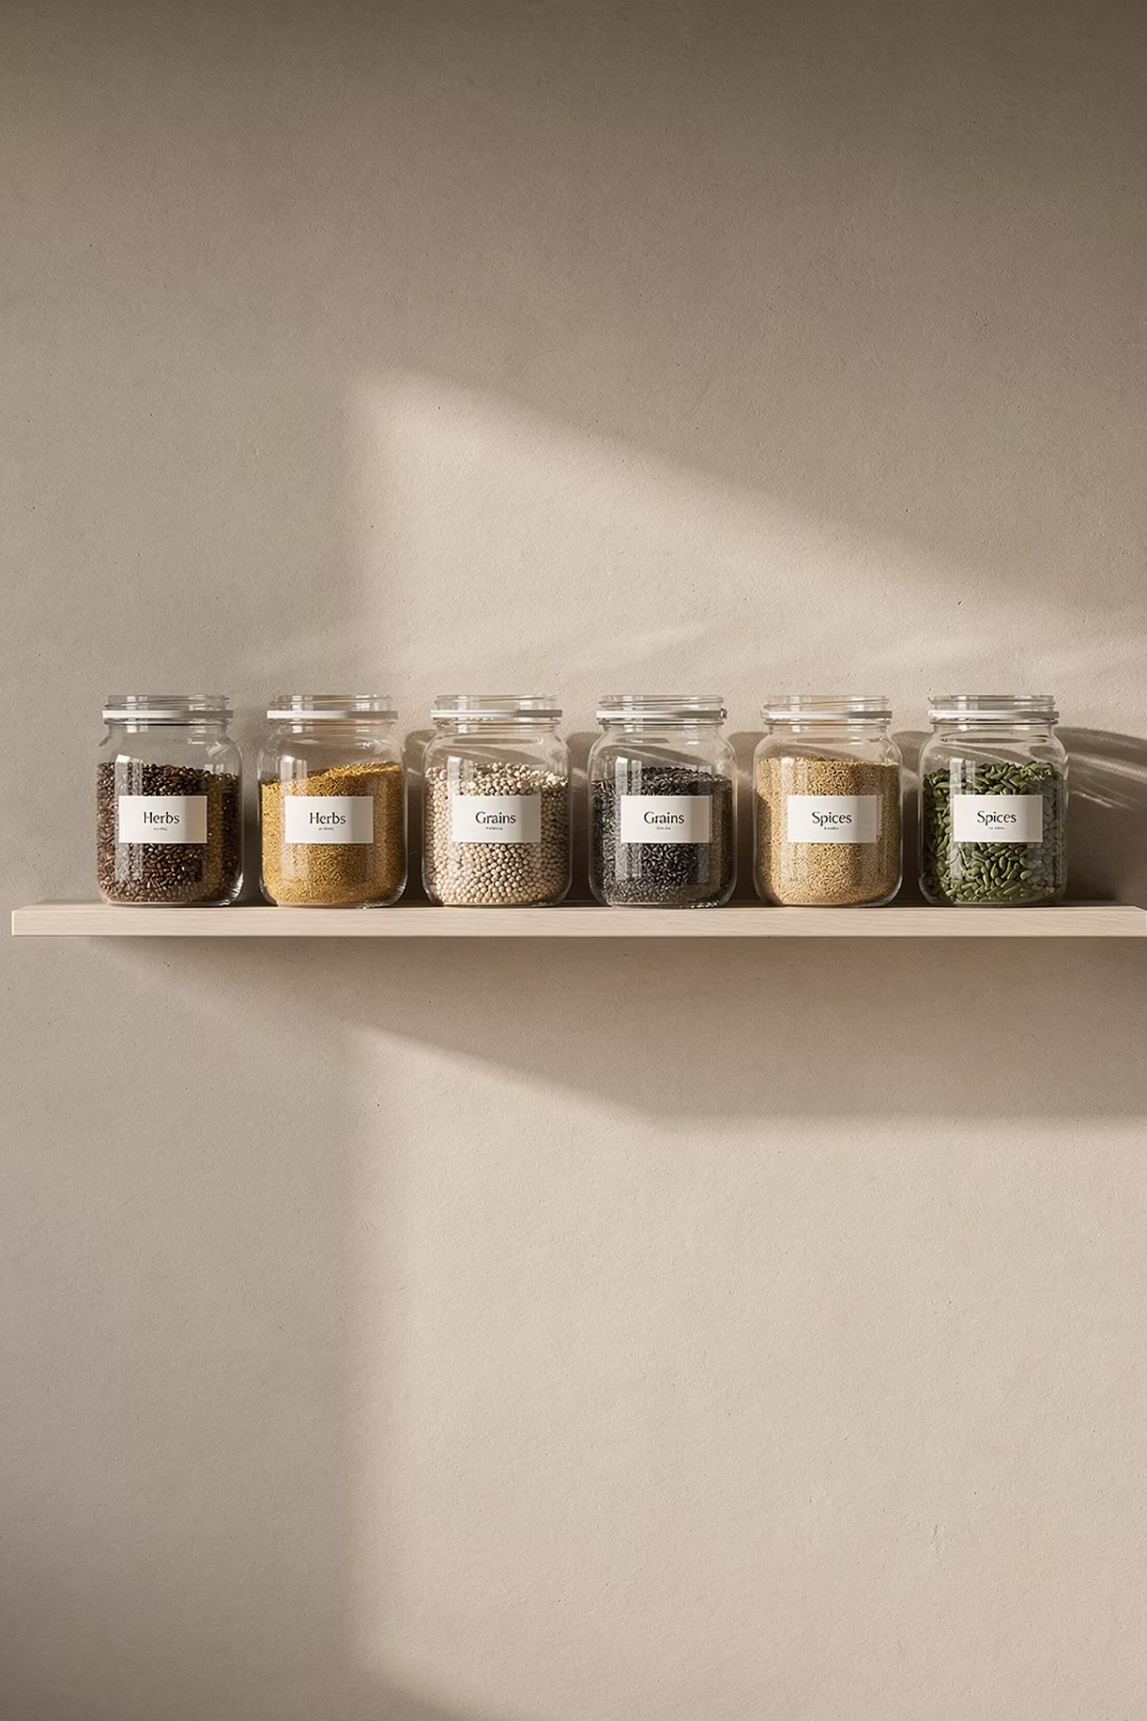

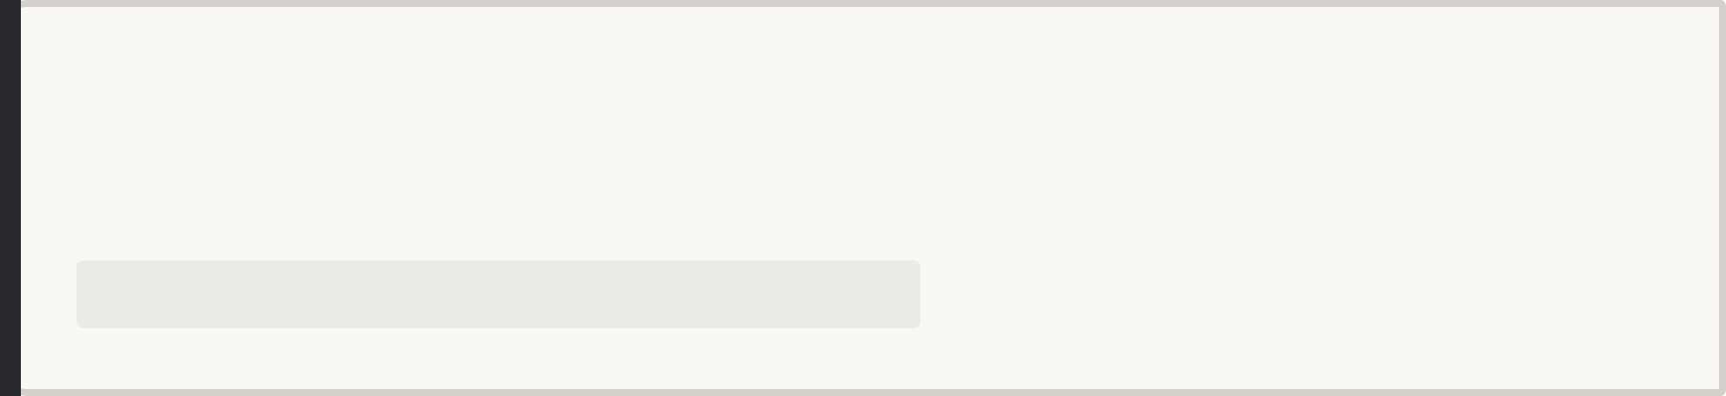
What Is a List?
Ordered Collection
A list stores multiple values in a single variable, keeping them in a defined order.
Mutable
Lists are mutable — you can change, add, or remove items after creation.
Square Bracket Syntax
Created with square brackets:
fruits = ["apple", "banana", "cherry"]

Slide 3

Creating Lists
Three Common Ways to Create a List
1
Empty List
2
Mixed Types
my_list = [] — start blank and fill it later as your program runs.
Python lists can hold strings, numbers, and booleans all together in one list.
3
From a Range
list(range(1, 6)) → [1, 2, 3, 4, 5]

Slide 4

Indexing & Slicing
Indexing
Slicing
IndexError
Indexing lets you grab a single item by position; slicing lets you grab a range. Remember: Python counts from 0, and negative indexes count from the end. Always stay within bounds to avoid an IndexError.

Slide 5



Adding & Removing Items
append(x)
remove(x)
pop(i)
Adds x to the end of the list. The list grows by one item.
fruits.append("mango")
Removes the first occurrence of x. Raises ValueError if not found.
fruits.remove("banana")
Removes and returns the item at index i. Defaults to the last item.
fruits.pop(0)

Slide 6


Sorting & Reversing
Python gives you two powerful in-place methods to reorder your list without creating a new one.
Both methods modify the list directly — no need to reassign the variable.
sort()
reverse()
Sorts the list ascending by default. Use sort(reverse=True) for descending order.
Flips the current order of the list in place — it does not sort, only reverses.

Slide 7


Iterating with a for Loop
Basic Loop
With enumerate()
Loop through every item without needing an index:
for fruit in fruits:
processes each item one by one.
Need both the index and the value? Use:
for i, val in enumerate(my_list):
— gives you position and item together.
fruits = ["apple", "banana", "cherry"]
# Basic loop
for fruit in fruits:
print(fruit)
# With index using enumerate()
for i, fruit in enumerate(fruits):
print(i, fruit)

Slide 8




Common List Errors
IndexError
Accessing an index beyond the list length. Always check len() before accessing by index.
ValueError
Calling remove(x) when x isn't in the list. Check with if x in my_list first.
TypeError
Trying to sort a list with mixed incompatible types — e.g. strings and numbers together.

Slide 9

What Is a Tuple?
Ordered Sequence
Immutable
Parenthesis Syntax
Once created, a tuple cannot be changed. No adding, removing, or editing items.
A tuple stores an ordered sequence of values — just like a list.
Created with parentheses:
point = (3, 7)

Slide 10
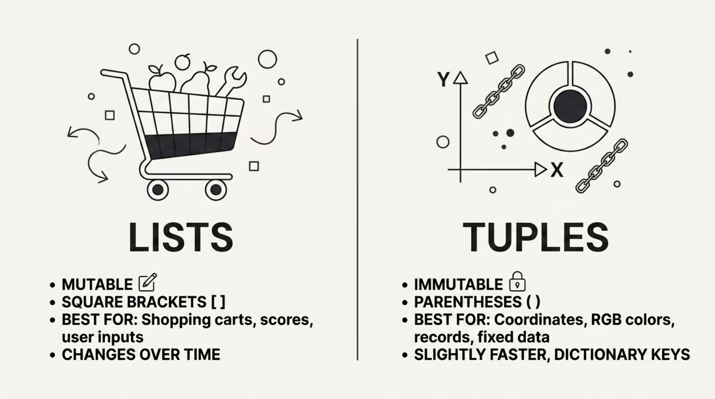

Tuples vs. Lists: When to Use Which
Choose a list when your data will change over time. Choose a tuple when your data should stay fixed — tuples are also slightly faster and can be used as dictionary keys, which lists cannot.

Slide 11
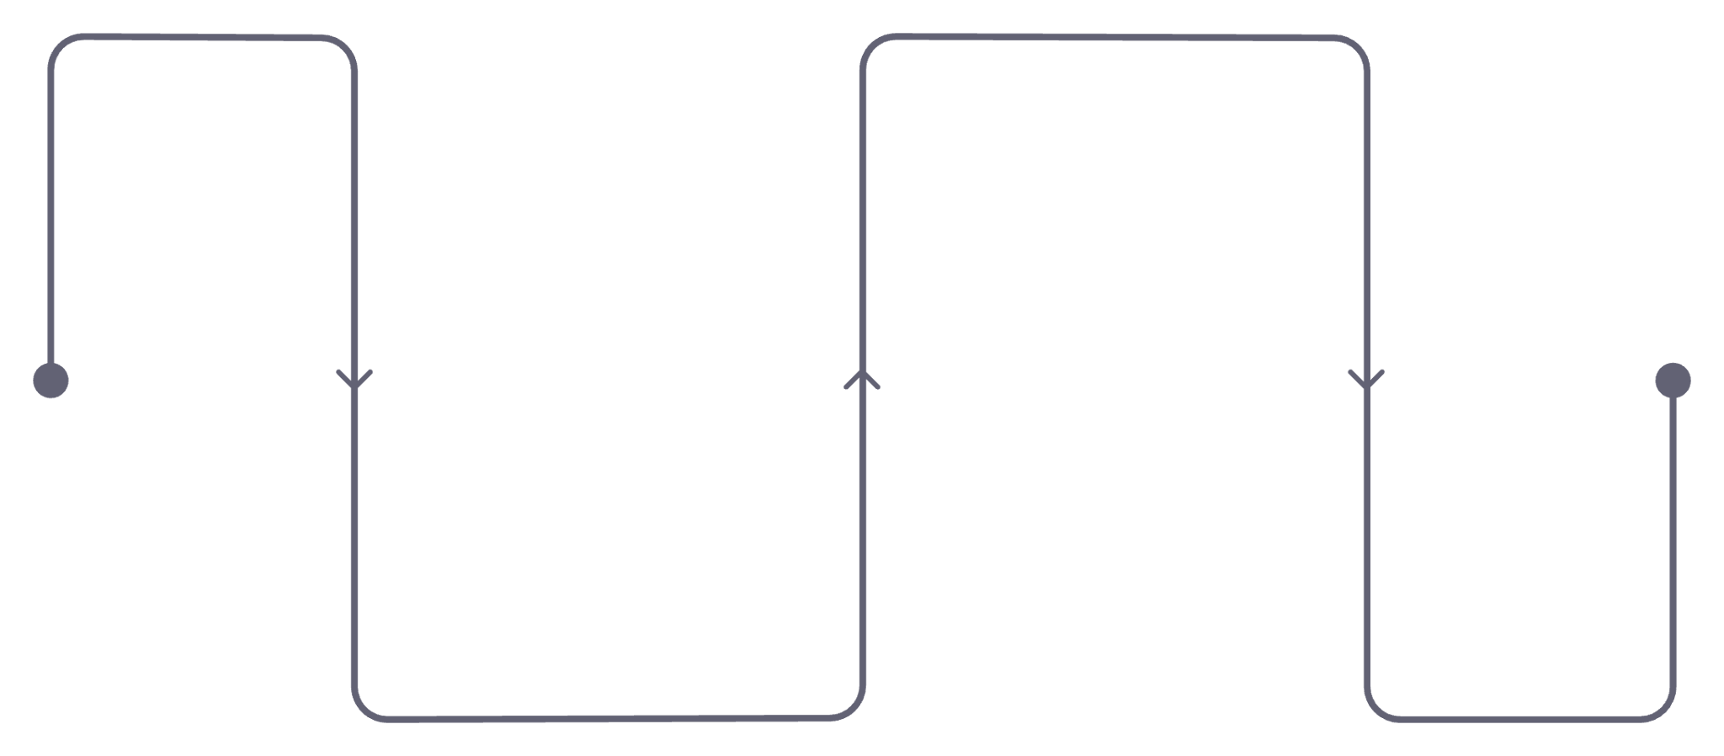

Nested Lists
Lists Inside Lists
A list can contain other lists as elements, creating a 2D structure — like a grid or matrix.
Select item
matrix[1][0] → 3
matrix = [[1, 2], [3, 4], [5, 6]]
# Access inner items with double indexing
print(matrix[1][0]) # → 3
Select row
matrix[1] → [3, 4]
Read matrix[1][0] as: "row 1, then column 0."

Slide 12
Storing Tabular Data in Lists
Nested lists can represent rows and columns — like a simple spreadsheet. Each inner list is one row of data (e.g. name, age, score). Use a nested for loop to process every cell.
Name
Age
Score
Alice
14
92
Bob
15
85
students = [
["Alice", 14, 92],
["Bob", 15, 85],
["Carol", 14, 78]
]
for student in students:
print(student[0], student[2])
Carol
14
78
Each row maps directly to an inner list — tidy, readable, and easy to iterate.

Slide 13

Putting It All Together
01
02
Sort & Print Names
Calculate Averages
Build a list of student names → sort alphabetically with sort() → print each with its index using enumerate().
Store quiz scores in a nested list → loop through each inner list → calculate the average score per student.
03
Mix Tuples & Lists
Use a tuple for fixed config values like screen size (800, 600) alongside mutable lists for dynamic data.

Slide 14




Key Takeaways
Lists Are Your Go-To
Tuples Stay Fixed
Ordered, mutable, and flexible — use lists for any collection of data that needs to change.
Immutable by design — use tuples for data that should never change, like coordinates or config values.
Nested Lists = 2D Data
Master the Core Methods
Lists inside lists unlock 2D structures. Always double-check your indexes when diving in.
append(), remove(), pop(), sort(), and for loops cover 90% of real use cases.

